Slide 1
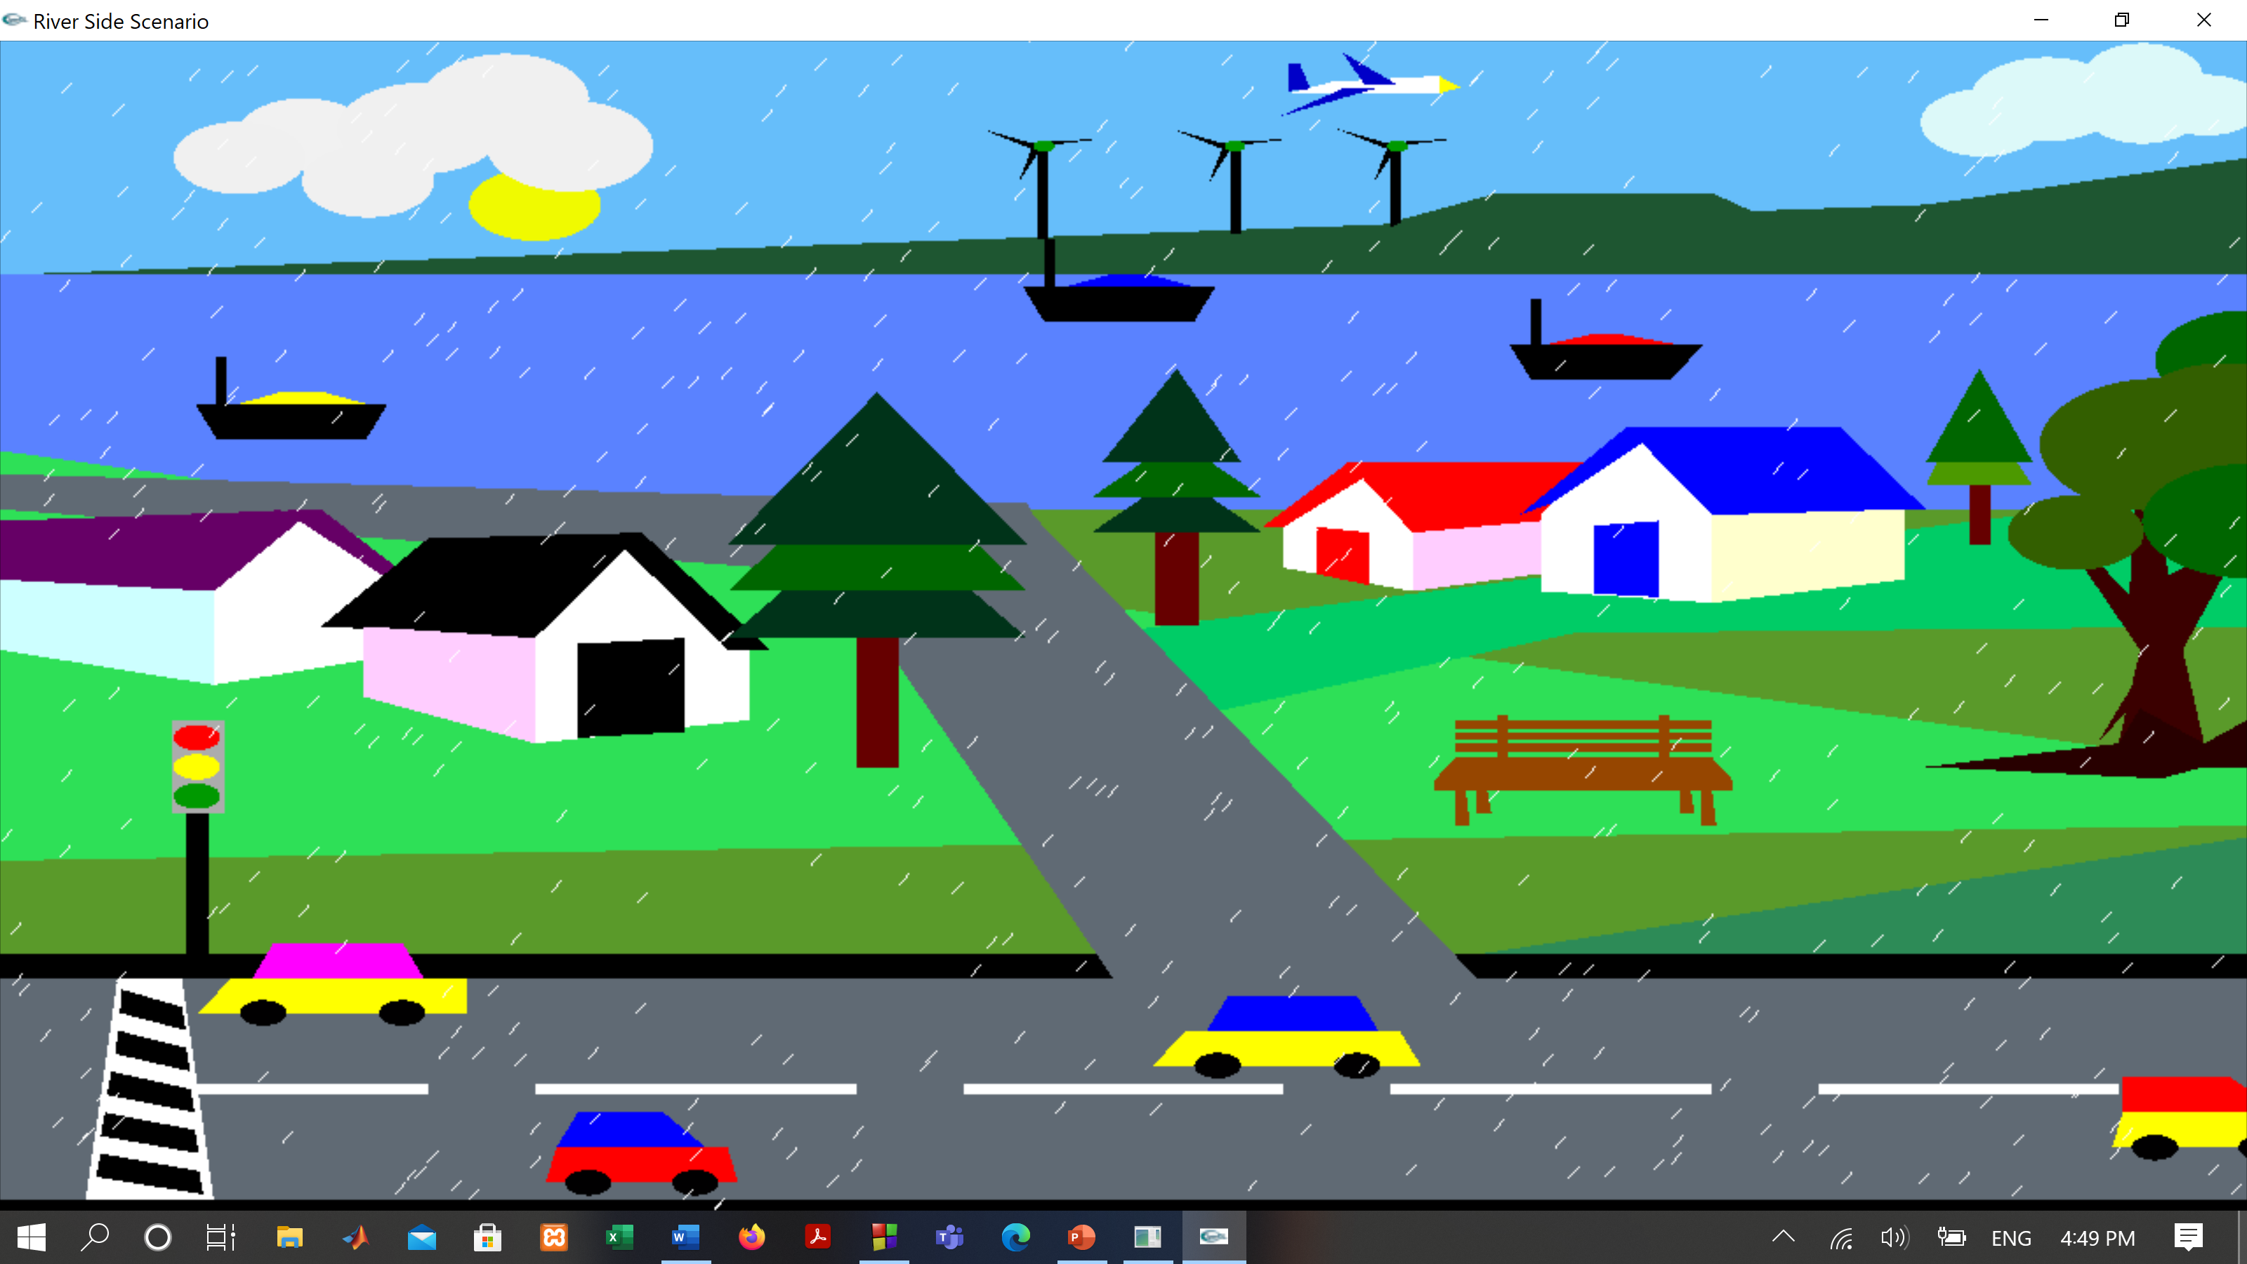
A Rainy-day MODERN VILLAGE scenario
Prepared And Presented By :
RUBAIA AKTER TONNI | 18-37969-2
RIFAT UZ ZAMAN | 18-38024-2
ESHAK AHMED | 18-38088-2
NUSRAT JAHAN | 18-38099-2
This Photo by Unknown Author is licensed under CC BY-SA-NC

Slide 2

CONTENTS
Full view
Introduction
Project Proposal
List of Objects
Sketch Diagram
Final Work
ESHAK And Nusrat’s Work
RIFAT and TONNI’s work
Sample code
ESHAK and Nusrat’s work
RIFAT and TONNI’s work
Output
ESHAK and Nusrat’s work
RIFAT and TONNI’s work
Conclusion
Thank You

Slide 3
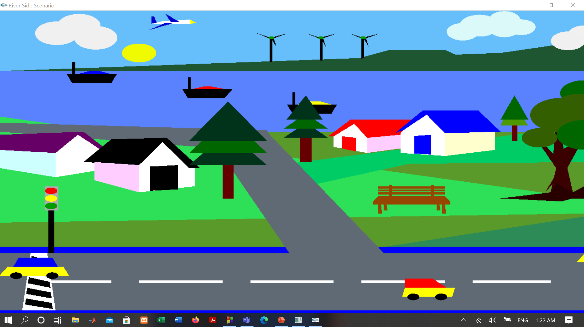
View Without Rain

Slide 4
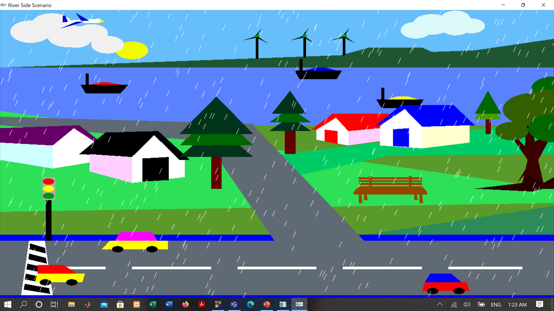
View with rain

Slide 5

Introduction
As the goal of the project was to develop A Rainy-day MODERN VILLAGE scenario. In this project, we are trying to show a simple Rainy-day MODERN VILLAGE scenario here by using OpenGL. The project is implemented by using the C++ programming language in Code Blocks (13.12) IDE. A visual C++ compiler is required to show this scenario. We know that Computer graphics is the backbone of any design and any visual representation. In this project, we design some houses, trees, clouds, roads, sun, boats, cars, a plane, windmills, sky, river, etc. We want to show the usual picture of a riverside small town on a sunny day. This project is well suited for designing 2D objects, as well as for carrying out basic graphic functionalities like drawing simple Quads, Polygons, Triangles. The project is enabled to work with mid-level OpenGL complexity.

Slide 6

Project Proposal
Project Name: A Rainy-day MODERN VILLAGE scenario
Feature List
1. Simple and complex shapes
2. Movement
3.Rotation
4. Rain Mode
5. Day Mode

Slide 7

List Of Objects
In this project, we want to show a clear A Rainy-day MODERN VILLAGE scenario. We make this view by using OpenGL. OpenGL is a software interface that allows a programmer to communicate with graphics hardware. Out of the many features available, the project demonstrates some popular and commonly used features of OpenGL, such as Rendering, Transformation, Rotation, Lighting, Scaling, etc. We use necessary library functions, user-defined functions, and loop here which is implemented by using the C++ language. We want to show the usual picture of a riverside small town on a sunny day. In this project, we design some houses, trees, clouds, roads, sun, boats, cars, planes, windmills, sky, river, etc. This project is well suited for designing 2D objects, as well as for carrying out basic graphic functionalities like drawing simple Quads, Polygons, Triangles. The project enabled me to work with mid-level OpenGL complexity.

Slide 8
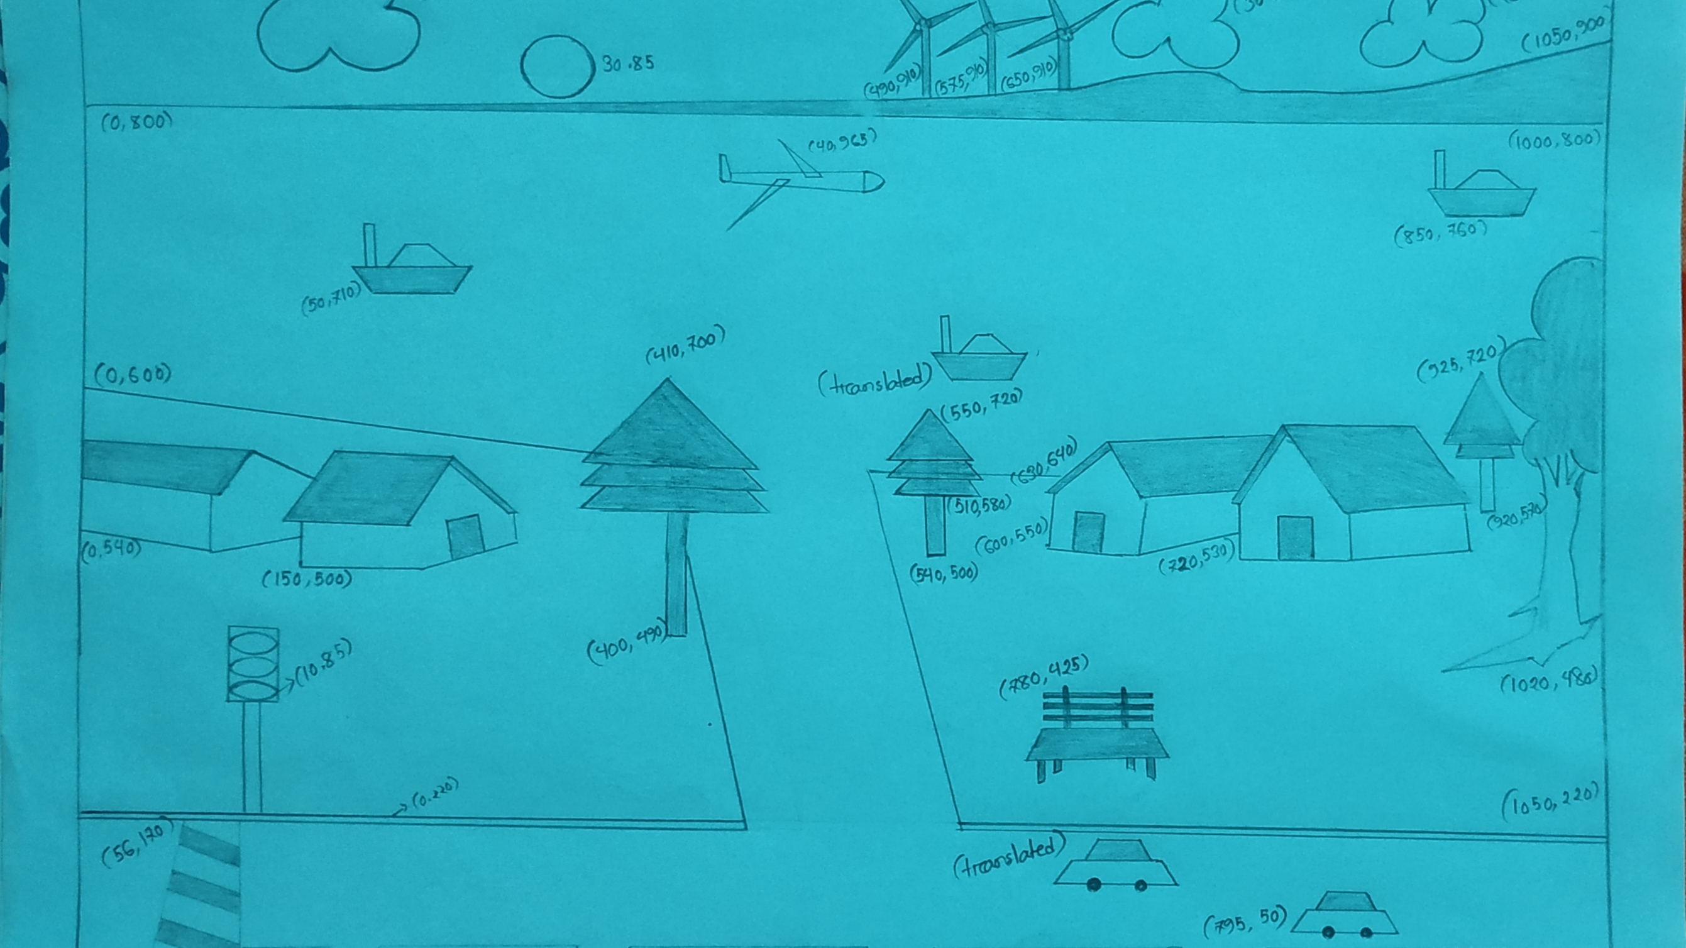
Final Sketch

Slide 9
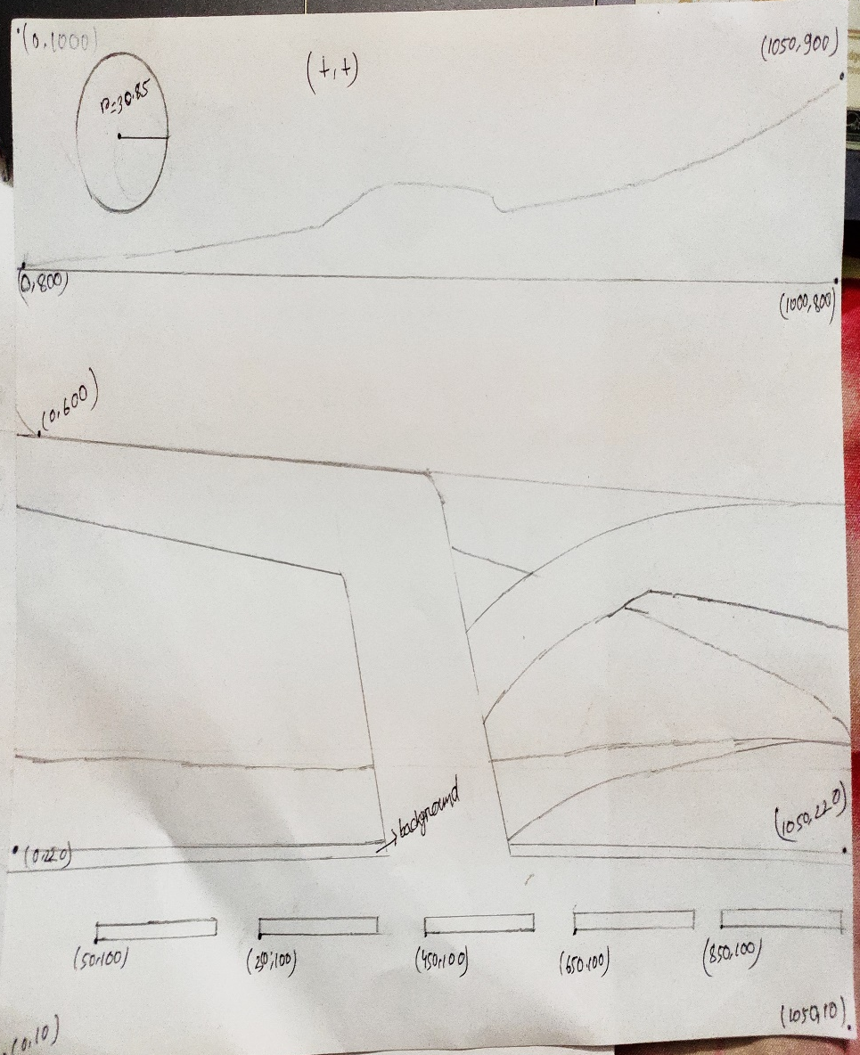
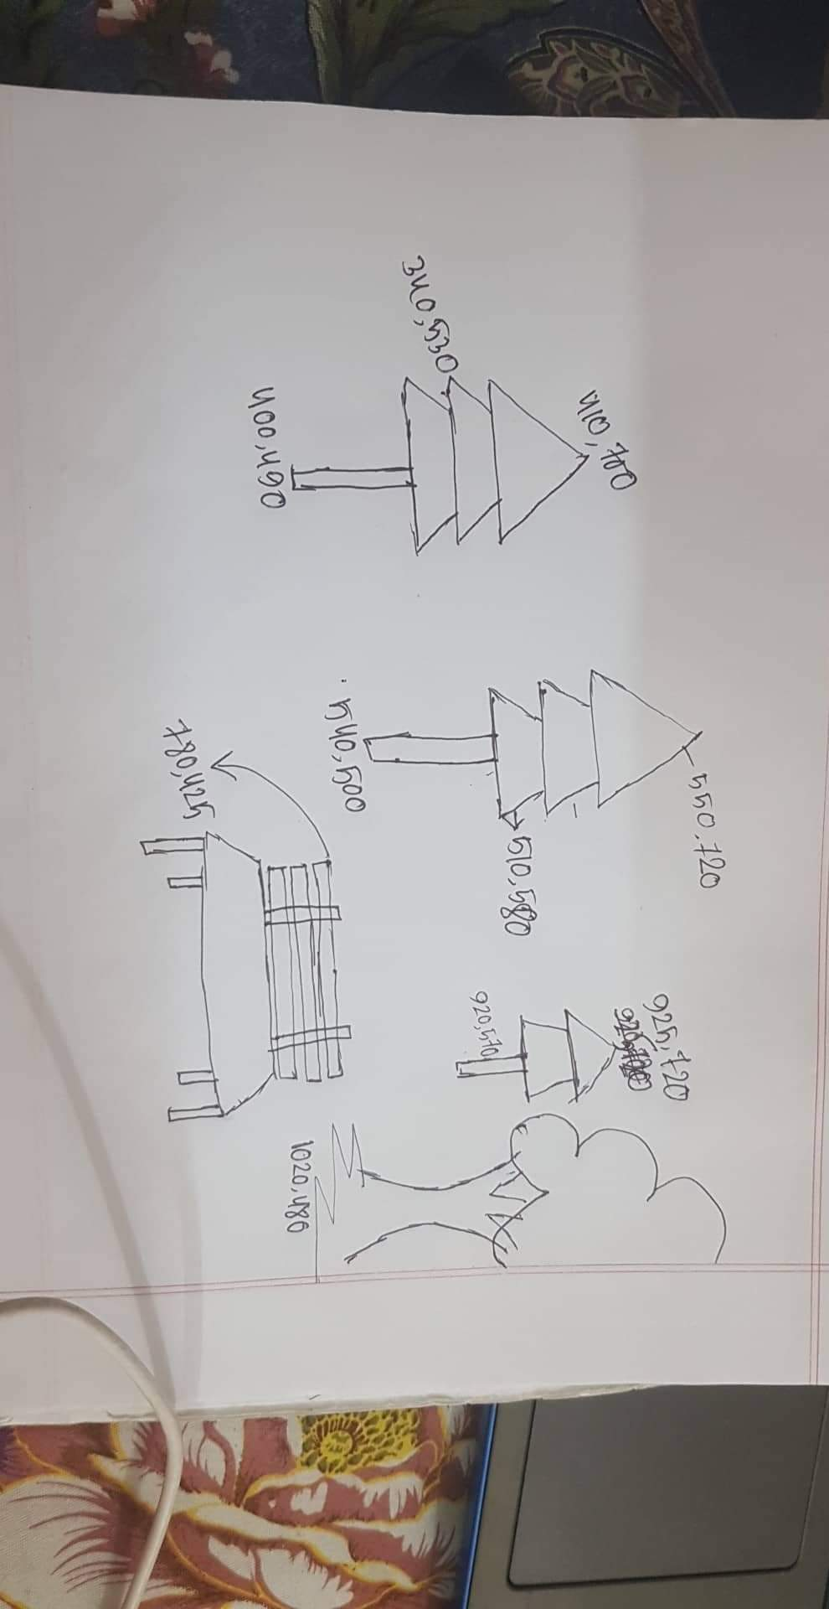
Sketch Diagram Of ESHAK And Nusrat

Slide 10
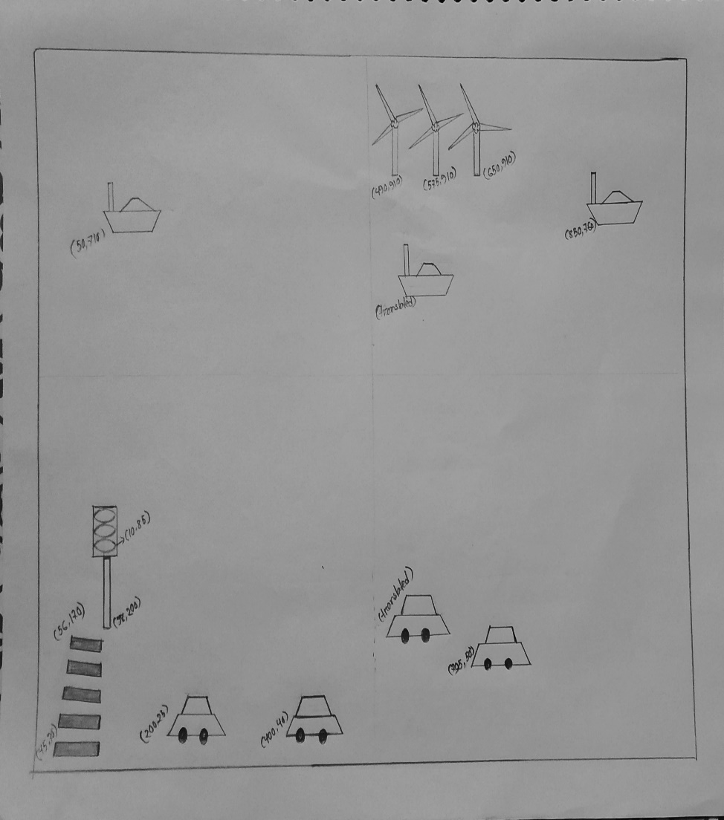
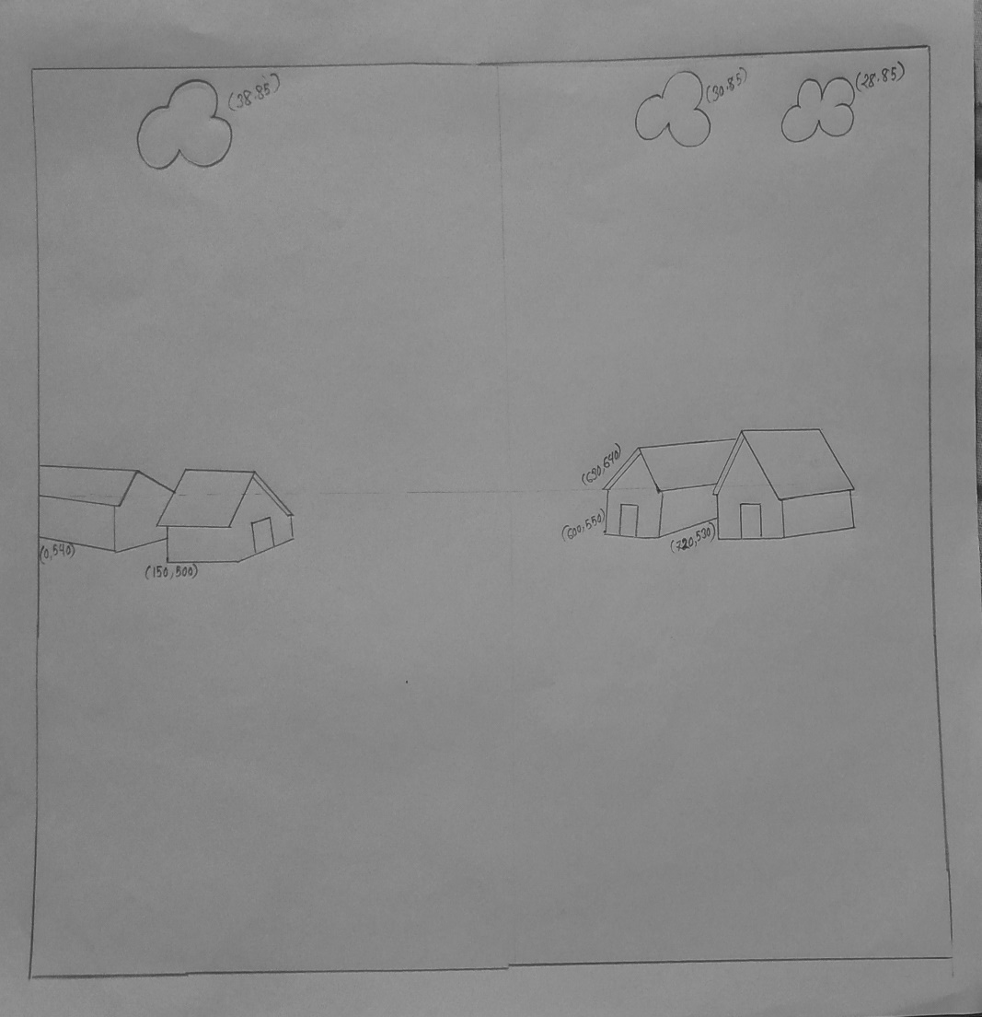
Sketch Diagram Of ESHAK And Nusrat

Slide 11
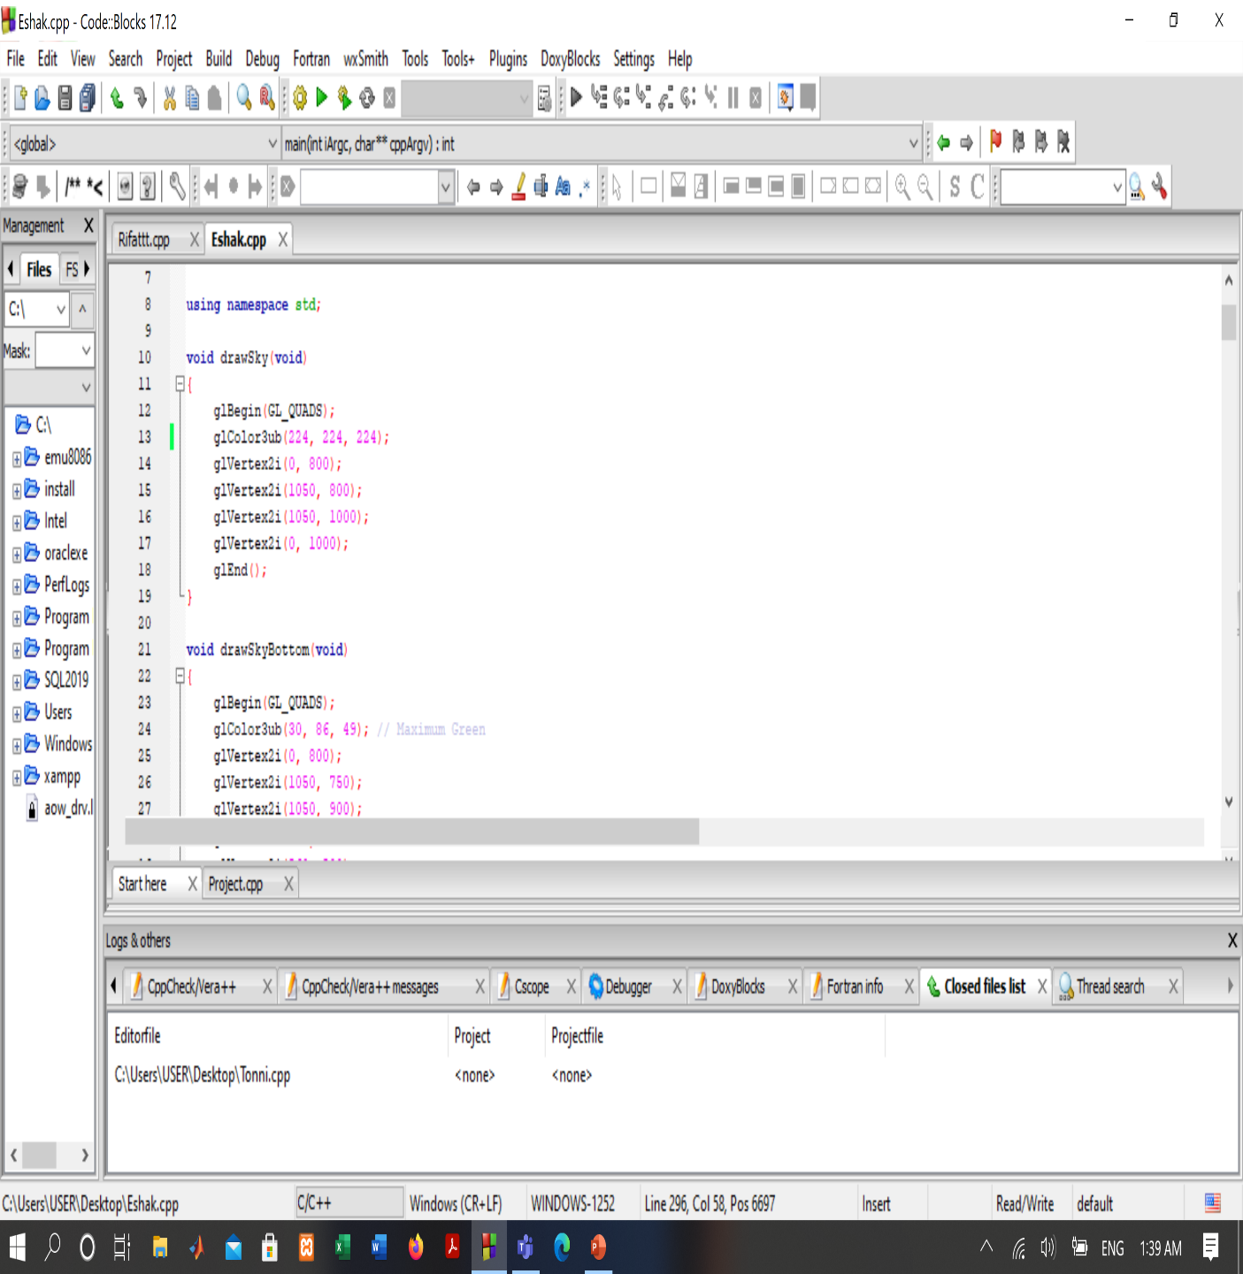
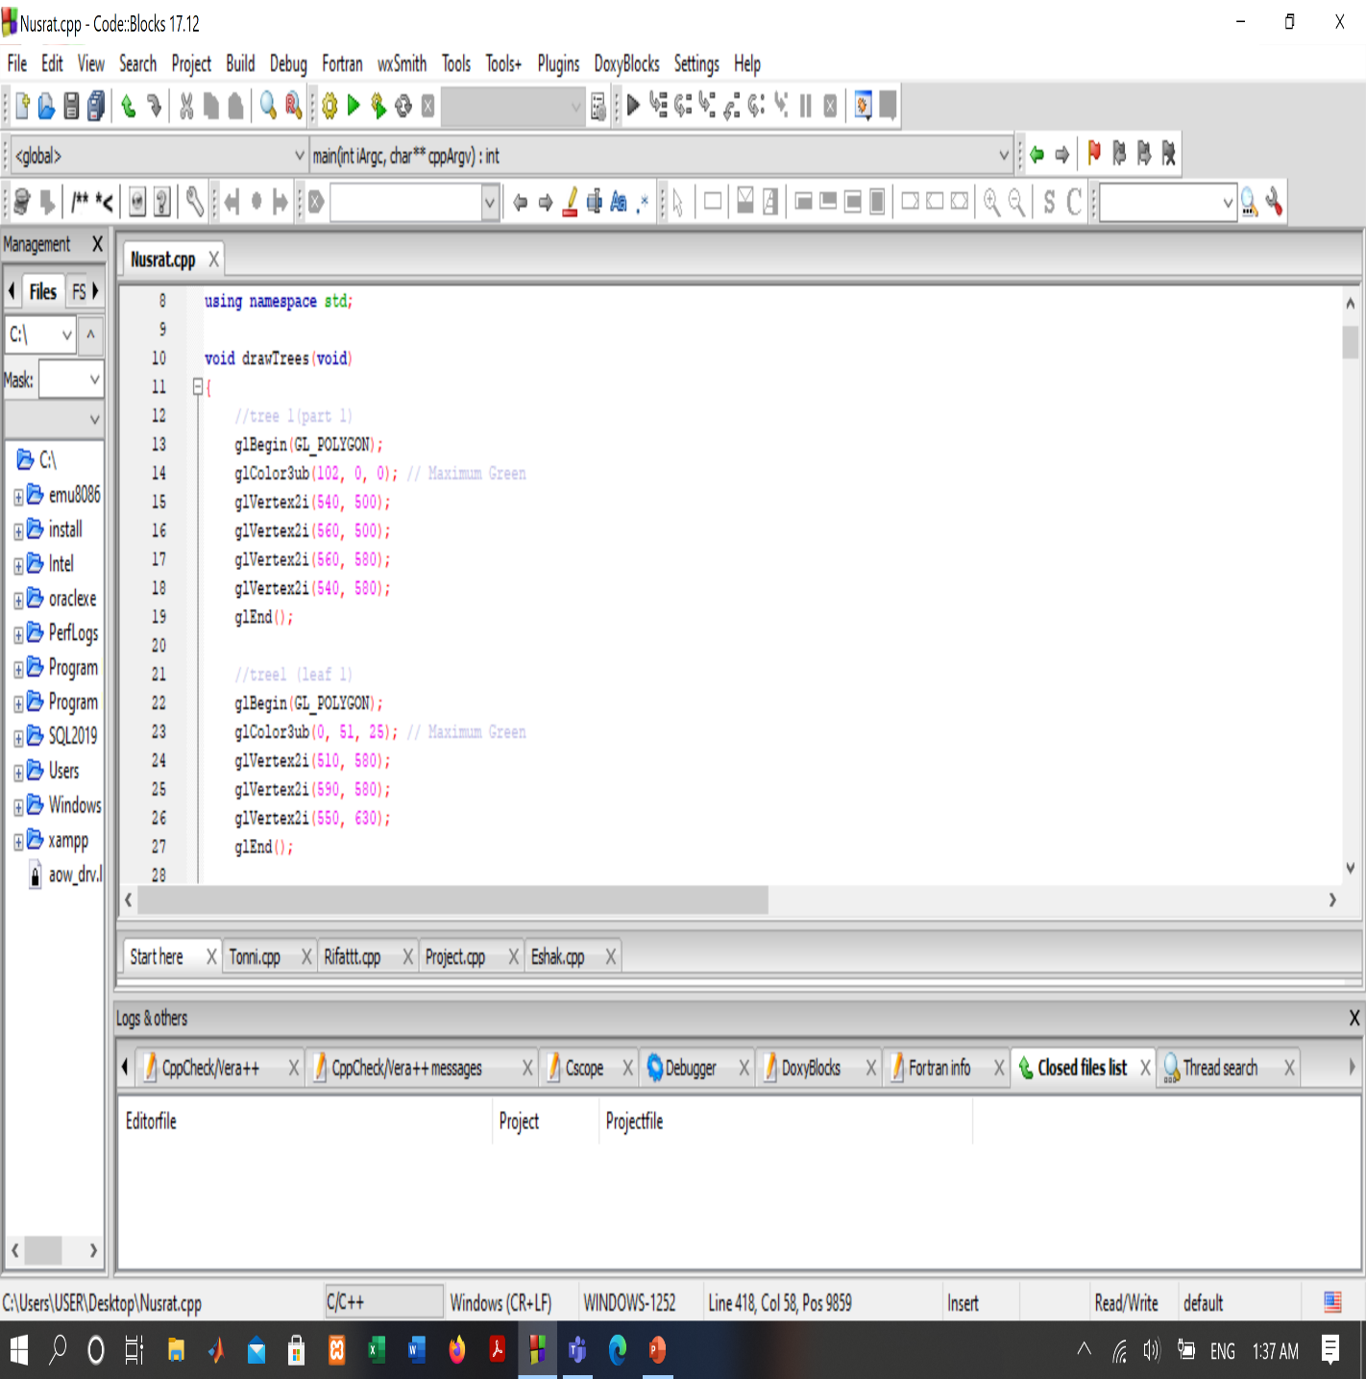
Simple codes of ESHAK and NUSRAT

Slide 12
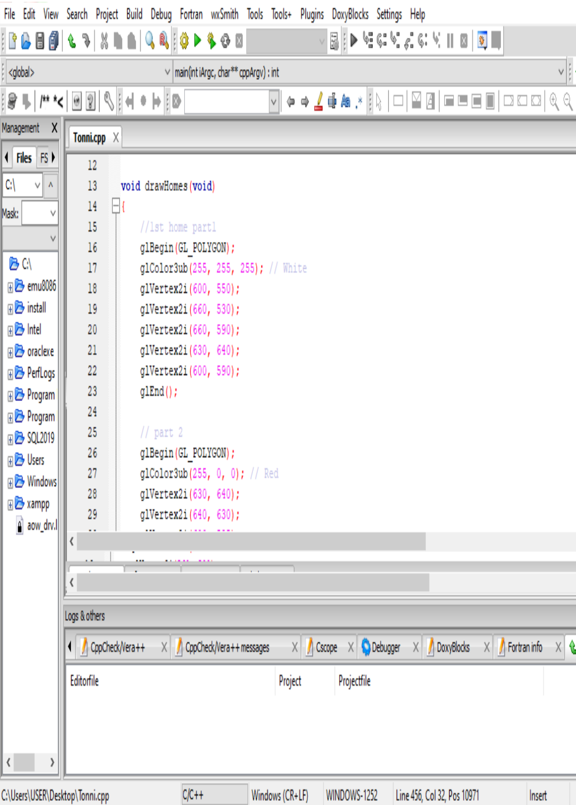
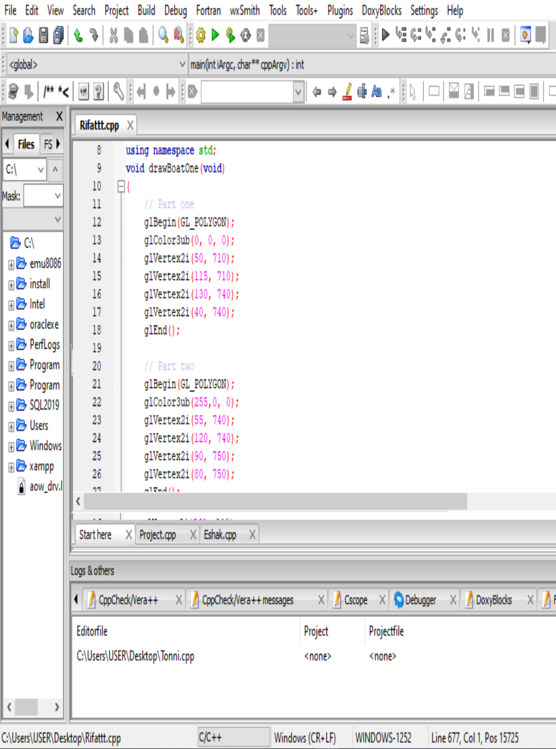
Sample codes of RIFAT and TONNI

Slide 13
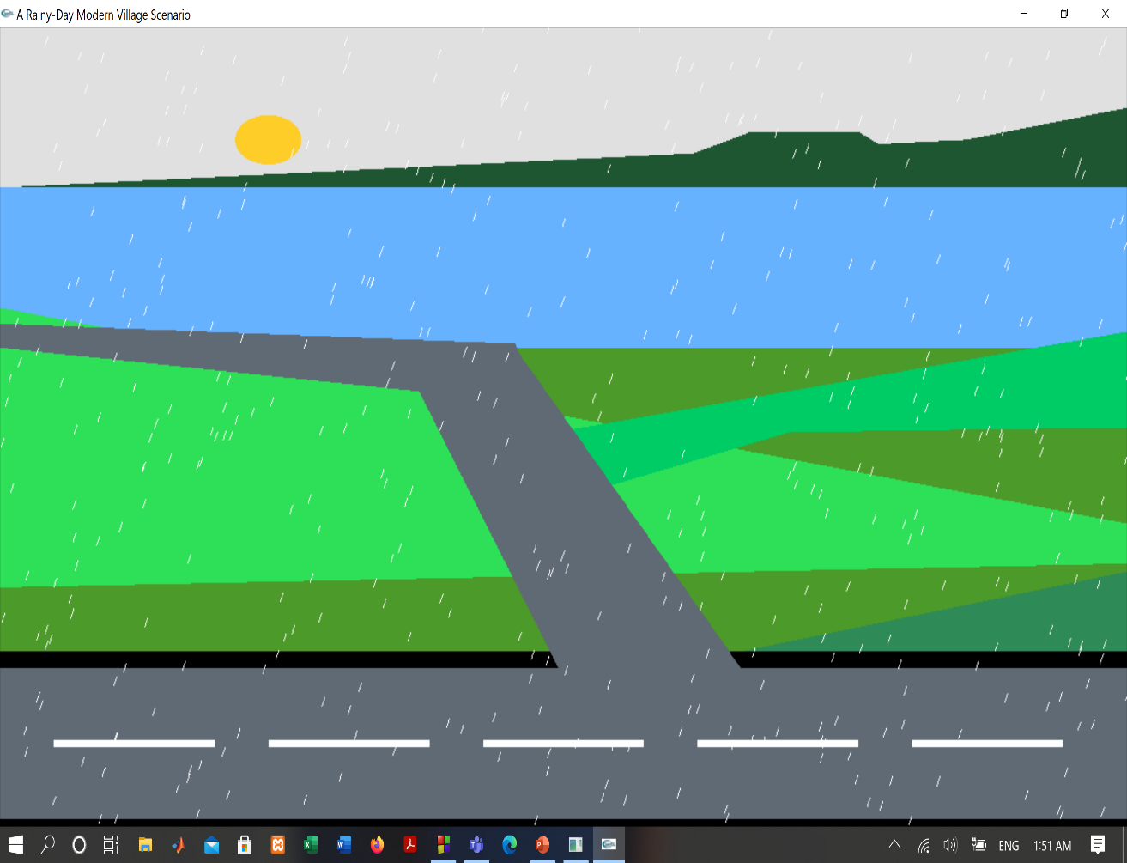
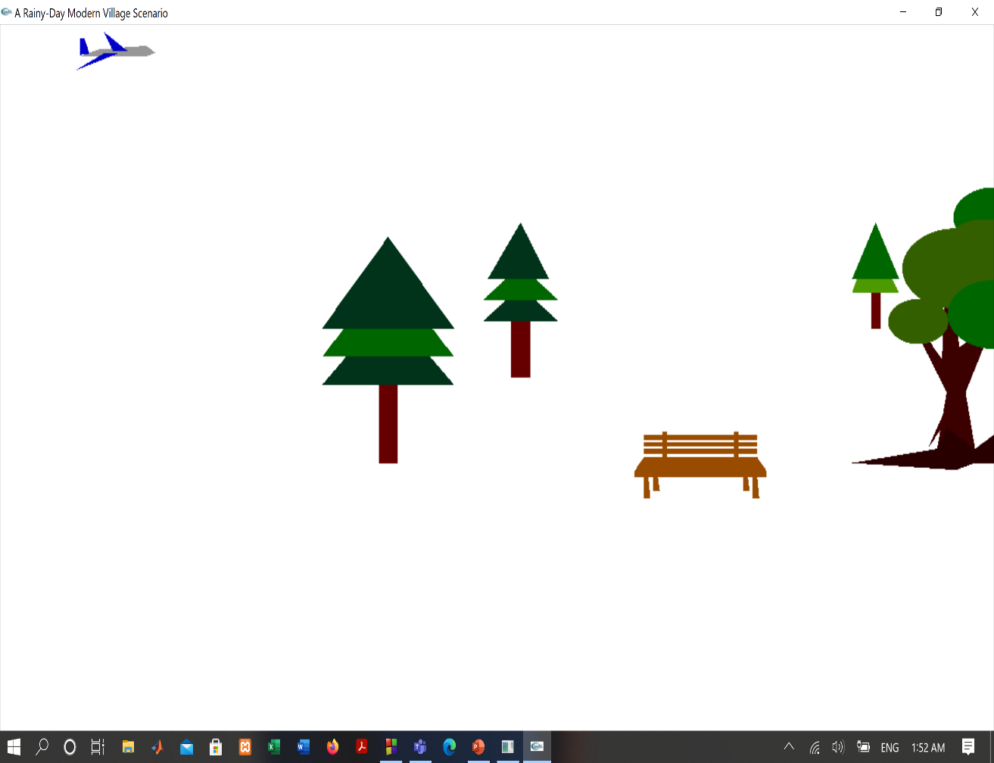
Output Of ESHAK And NUSRAT’s Code

Slide 14
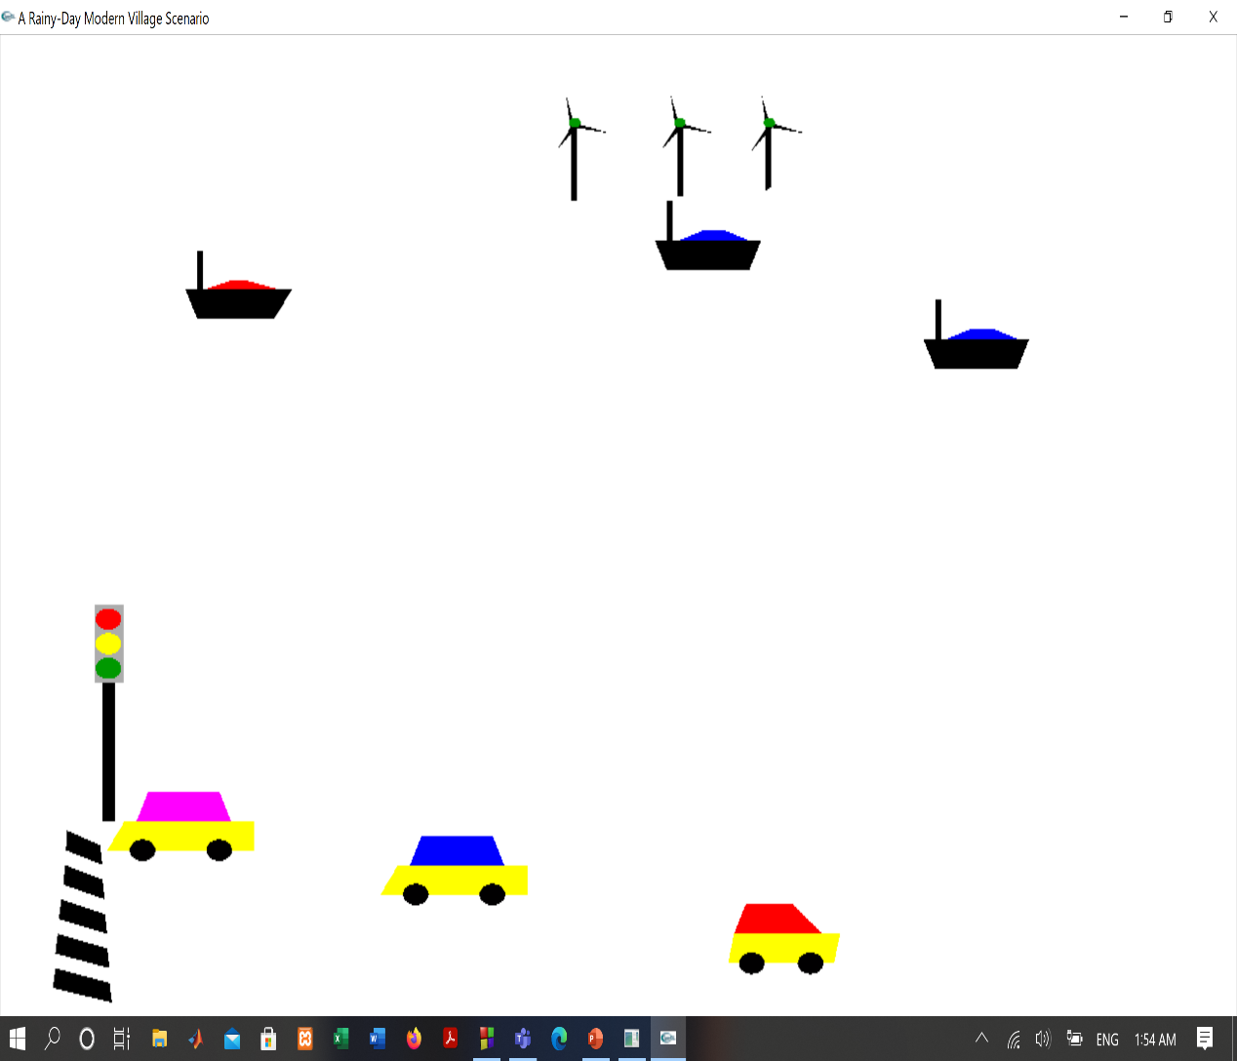
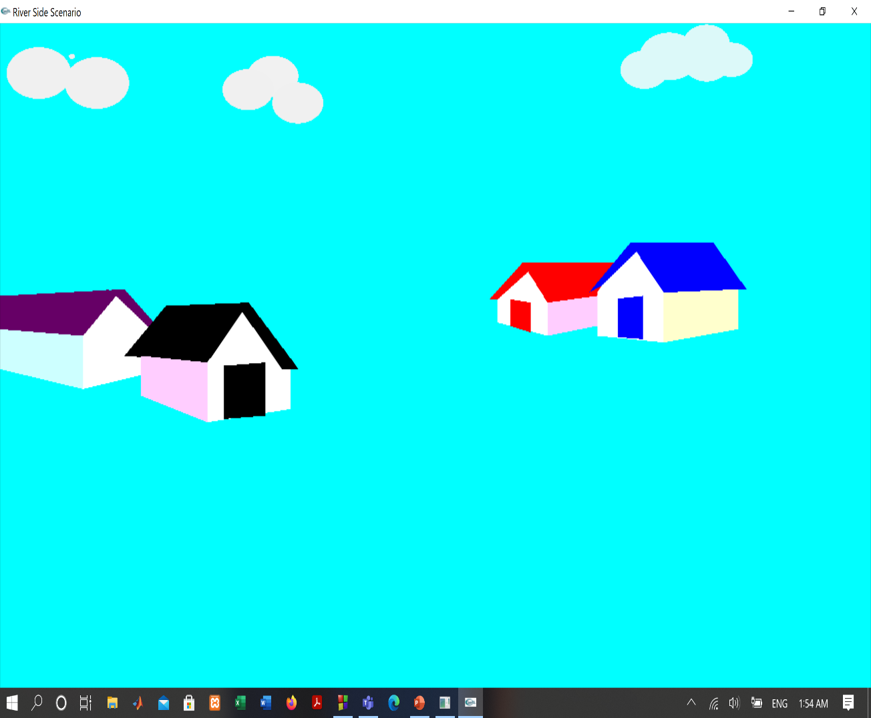
Output Of RIFAT And TONNI’s Code

Slide 15

conclusion
In this project, we want to show a clear riverside scenario. We make this view by using OpenGL. OpenGL is a software interface that allows a programmer to communicate with graphics hardware. Out of the many features available, the project demonstrates some popular and commonly used features of OpenGL, such as Rendering, Transformation, Rotation, Lighting, Scaling, etc. We use necessary library functions, user-defined functions, and loop here which is implemented by using the C++ language.

Slide 16

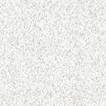
THANK YOU

